Slide 1

UNIVERSITY MOHAMED V
faculty of sciences Rabat
INFO department
1st Year Master SID
Biomedical Field : Breast Cancer Prediction
By : SIDI ELY Mohamed saleh RABANY Brahim
Supervisor : Imane LASRI

Slide 2
TABLE OF CONTENTS
01
02
03
INTRODUCTION
Project Overview
Medical DM apps
04
05
06
DM algorithms
Demo
CONCLUSION
Introduction
Overview of the project
Examples of DM apps
DM algorithms for prediction
Implementation
Conclusion

Slide 3
01
INTRODUCTION
Introduction

Slide 4

Introduction
Breast cancer is the most commonly diagnosed cancer type, accounting for 1 in 8 cancer diagnoses worldwide. In 2020, there were about 2.3 million new cases of breast cancer.
Fine needle aspiration(FNA) is a type of biopsy procedure.

Slide 5
02
PROJECT OVERVIEW
Overview of the project

Slide 6

Aim of the Project
The objective of this report is to train machine learning models to predict whether a breast cancer cell is Benign or Malignant.
Notes:
Mammography is the most common mass screening tool for an early detection of breast cancers because of its sensitivity in recognising breast masses.
After detection of suspicious breast masses, a biopsy test procedure would be carried out, such as Fine Needle Aspirates (FNA), that is the method this report focus on
Breast cancer has become the most recurrent type of health issue among women especially for women in middle age. Early detection of breast cancer can help women cure this disease and death rate can be reduced. In the present-day scenario, to observe breast cancer mammograms are used and they are known be the most effective scanning technique.
Mammography is the most common mass screening tool for an early detection of breast cancers because of its sensitivity in recognising breast masses. After detection of suspicious breast masses, a biopsy test procedure would be carried out, such as Fine Needle Aspirates (FNA), that is the method this report focus on. This method has been shown to be safe, cost-effective, accurate and fast. A small drop of viscous fluid is aspired from the breast masses to be analyzed under the microscope. Then, a small region of the breast mass cells is photographed in a grayscale image and further analyzed using an image analysis program ‘Xcyt’. This program uses a curve-fitting to determine the edges of the nuclei from initial dots manually placed near these edges by a mouse.

Slide 7
DATASET
Features are computed from a digitized image of a fine needle aspirate (FNA) of a breast mass. They describe characteristics of the cell nuclei present in the image.
Ten real-valued features are computed for each cell nucleus:
radius (mean of distances from center to points on the perimeter)
texture (standard deviation of gray-scale values)
Perimeter
Area
smoothness (local variation in radius lengths)
compactness (perimeter^2 / area - 1.0)
concavity (severity of concave portions of the contour)
concave points (number of concave portions of the contour)
Symmetry
fractal dimension ("coastline approximation" - 1)

Slide 8


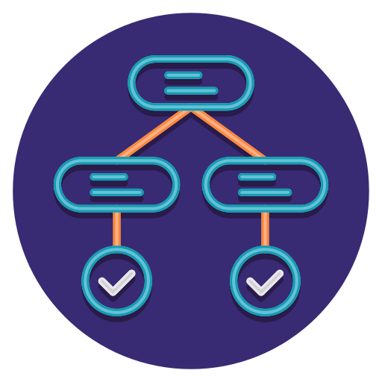

WORKFLOW
Dataset
Data pre-processing
Split data
Random Forest Model
Benign (Or) Malignant
Input
Trained Random Forest Model
Prediction

Slide 9
03
MEDICAL DM APPS
Examples of DM apps
Notes:
In today's medical field, data mining is mostly utilized to anticipate various diseases, assist with diagnosis, and advise clinicians on clinical decisions.

Slide 10

Clinical Decision-Making Is Improved
The use of CDSS is becoming more frequent in hospitals (clinical decision support systems). These systems either make decisions based on a knowledge base and rules or employ machine learning to generate conclusions based on data analysis.

Slide 11
Measuring The Efficacy Of Treatment
Data mining may compare and contrast symptoms in a clear and transparent manner, while also explaining the core reason and arranging the most successful treatment approaches.

Slide 12
Reduces The Risk Of Drug Interactions
Mining tools are used by medical organizations to assist doctors in deciding when to give medication. Because of the potential for lethal interactions, a patient may need to cease taking another prescription in order to take some pharmaceuticals. Analysts can utilize healthcare data to prevent these interactions from happening in the first place.

Slide 13
Increased Diagnostic Precision
In medical, data mining enables clinicians to make more conclusive, evidence-based diagnoses in less time. While a skilled clinician must still make the final choice, AI-enabled software can evaluate large amounts of data in seconds.

Slide 14
Breast Cancer Prediction
What is Cancer ?
There are many types of cancer. Cancer can develop anywhere in the body and is named for the part of the body where it started.
What is Tumor ?
A tumor is a lump or growth. Some lumps are cancer, but many are not.
Lumps that are not cancer are called benign
Lumps that are cancer are called malignant
When Cancer start ?
Cancer starts when cells begin to grow out of control.
Notes:
For instance, breast cancer that starts in the breast is still called breast cancer even if it spreads (metastasizes) to other parts of the body

Slide 15
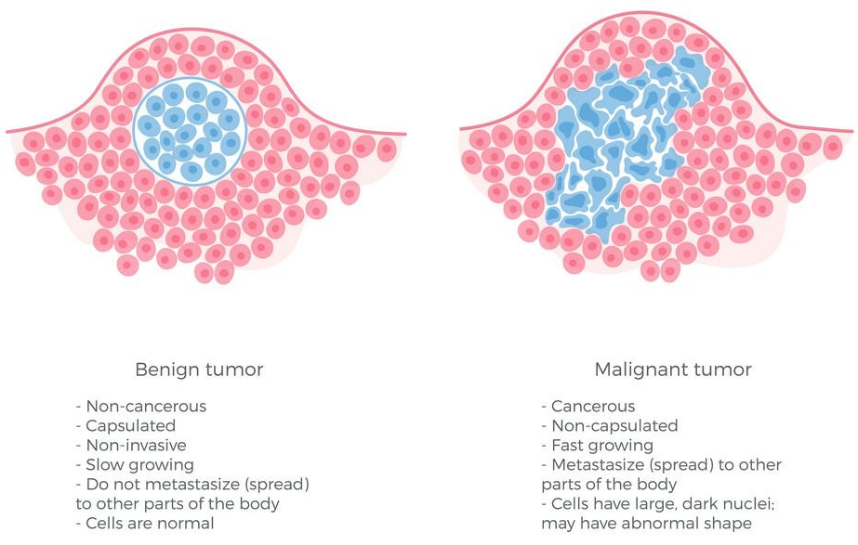
Breast Cancer Prediction(2)
Notes:
For instance, breast cancer that starts in the breast is still called breast cancer even if it spreads (metastasizes) to other parts of the body

Slide 16
04
DM ALGORITHMS
DM algorithm for prediction

Slide 17
Prediction Algorithms
Usually Data Mining use different kinds of Machine Learning algorithms for large data sets. But, at a high level all those different algorithms can be classified in two groups :
Supervised learning is a type of system in which both input and desired output data are provided. can be further grouped into Regression and Classification problems
Unsupervised learning is the algorithm using information that is neither classified nor labeled and allowing the algorithm to act on that information without guidance.
So we will use the Classification algorithm of supervised learning.
We have different types of classification algorithms in Machine Learning :
Notes:
For instance, breast cancer that starts in the breast is still called breast cancer even if it spreads (metastasizes) to other parts of the body

Slide 18



Random Forest
Random forest is a Supervised Machine Learning Algorithm that is used widely in Classification and Regression problems. It builds decision trees on different samples and takes their majority vote for classification and average in case of regression.
Ask doctors
Doctors answers
Final Result
Notes:
Before we dive into logistic Regression, let’s take a step back and review linear regression.

Slide 19
Random Forest
A decision tree is a flowchart-like structure in which each internal node represents a "test" on an attribute
Doctor 1
Doctor 2
Doctor 3
Answer
Answer
Answer
0
1
1
0
0
1
1
0
1
Notes:
Before we dive into logistic Regression, let’s take a step back and review linear regression.

Slide 20

Random Forest
Id | x₀ | x₁ | x₂ | x₃ | x₄ | y
0 | 1.3 | 2.5 | 6.3 | 2.6 | 1.1 | 1
1 | 3.9 | 1.2 | 4.5 | 2.3 | 5.7 | 1
2 | 6.6 | 3.4 | 1.2 | 4.8 | 1.4 | 0
3 | 4.6 | 2.9 | 3.5 | 7.3 | 3.2 | 0
Id
0
1
2
0
Id
1
1
3
0
Id
2
2
0
1
Id
3
2
3
0
Bootstrapped Dataset

Slide 21
Random Forest
Id | x₀ | x₁ | x₂ | x₃ | x₄ | y
0 | 1.3 | 2.5 | 6.3 | 2.6 | 1.1 | 1
1 | 3.9 | 1.2 | 4.5 | 2.3 | 5.7 | 1
2 | 6.6 | 3.4 | 1.2 | 4.8 | 1.4 | 0
3 | 4.6 | 2.9 | 3.5 | 7.3 | 3.2 | 0
Id
0
1
2
0
Id
1
1
3
0
Id
2
2
0
1
Id
3
2
3
0
X₀, X₁
X₂, X₃
X₂, X₀
X₁, X₃
X₀<2.3
X₃>4.3
X₂<2.3
X₁<2.3
3.1 | 1.2 | 9.5 | 7.3 | 3.2
X₁>5.3
1
0
1
X₀<5.1
1
X₃>5.1
0
Bootstrap + Aggregating
(Bagging)
1
0
0
1
1
0
1
0
1
1
Result : 1

Slide 22
Advantages and Disadvantages of Random Forest
It can be used in classification and regression problems.
It solves the problem of overfitting as output is based on majority voting or averaging.
It performs well even if the data contains null/missing values.
It is highly stable as the average answers given by a large number of trees are taken.
It is immune to the curse of dimensionality. Since each tree does not consider all the attributes, feature space is reduced.
We don’t have to segregate data into train and test as there will always be 30% of the data which is not seen by the decision tree made out of bootstrap.
Notes:
Before we dive into logistic Regression, let’s take a step back and review linear regression.

Slide 23
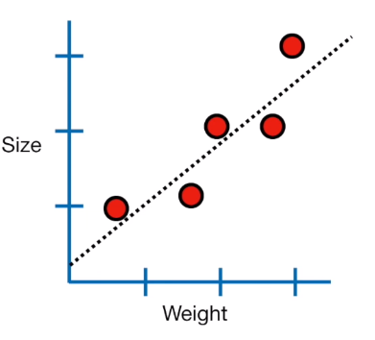
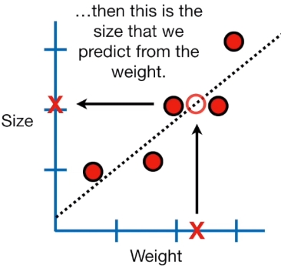
Logistic Regression
Logistic regression analysis studies the association between a categorical dependent variable and a set of independent (explanatory) variables.
Notes:
Before we dive into logistic Regression, let’s take a step back and review linear regression.

Slide 24
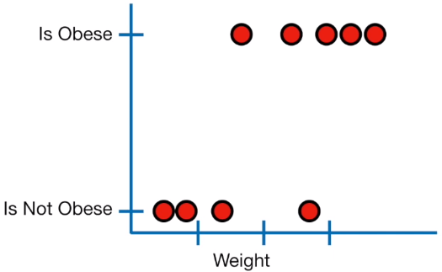
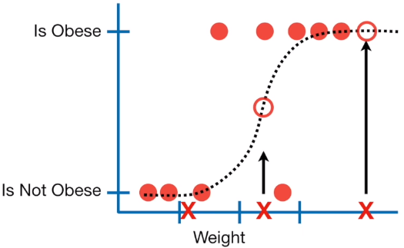
Logistic Regression(2)
Instead of Logistic Regression we can predict binary result.

Slide 25
Types Of Logistic Regression
Binary Logistic Regression
Multinomial Logistic Regression
Ordinal Logistic Regression

Slide 26
Binary Logistic Regression
Binary logistic regression was mentioned earlier in the case of classifying an object as an animal or not an animal—it’s an either/or solution. There are just two possible outcome answers. This concept is typically represented as a 0 or a 1 in coding. Examples include:
Whether or not to lend to a bank customer (outcomes are yes or no).
Assessing cancer risk (outcomes are high or low).
Will a team win tomorrow’s game (outcomes are yes or no).

Slide 27
Multinomial Logistic Regression
Multinomial logistic regression is a model where there are multiple classes that an item can be classified as. There is a set of three or more predefined classes set up prior to running the model. Examples include:
Classifying texts into what language they come from.
Predicting whether a student will go to college, trade school or into the workforce.
Does your cat prefer wet food, dry food or human food?

Slide 28
Ordinal Logistic Regression
Ordinal logistic regression is also a model where there are multiple classes that an item can be classified as; however, in this case an ordering of classes is required. Classes do not need to be proportionate. The distance between each class can vary. Examples include:
Ranking restaurants on a scale of 0 to 5 stars.
Predicting the podium results of an Olympic event.
Assessing a choice of candidates, specifically in places that institute ranked-choice voting.

Slide 29
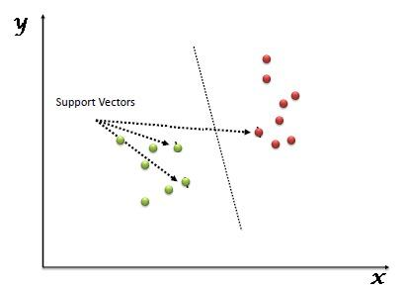
Support Vector Machine (SVM)
Support Vector Machine (SVM) is a supervised machine learning algorithm that can be used for both classification or regression challenges. In the SVM algorithm, we plot each data item as a point in n-dimensional space. Then, we perform classification by finding the hyper-plane that differentiates the two classes very well

Slide 30
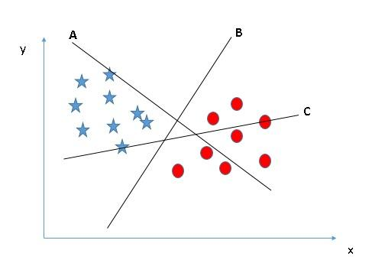
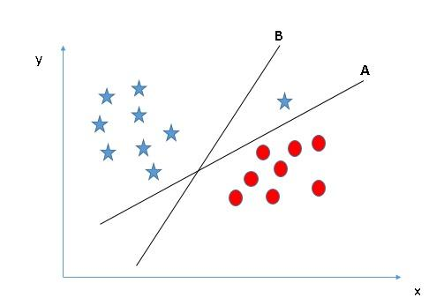
Support Vector Machine (SVM)
Scenarios :

Slide 31
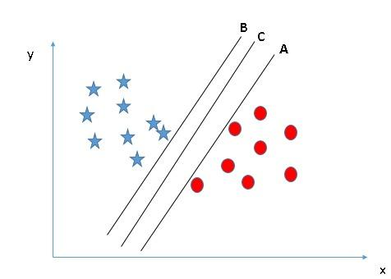
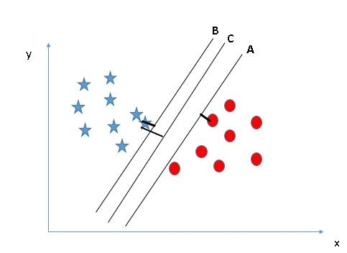
Support Vector Machine (SVM)

Slide 32
05
DEMO
Implementation

Slide 33
Thanks!
Do you have any questions?
Please keep this slide for attribution

